Slide 1
R&D - Final Presentation
Title: Network Inversion in Natural Language Processing
Supervisor:
Prof. Amit Sethi
PhD TA:
Suhail Pirzada
Presented by:
Madhav Gupta
(21D070043)

Slide 2
Problem Statement
Inversion Goal: Reconstruct input text sequences for sentiment labels to reveal learned features, patterns, and biases
Sentiment-Conditioned Text Generator: Invert the transformer to understand how sentiment conditioning (ex. positive/negative vectors) shapes generated text
LLM Previous Token Prediction: Invert large language models to reconstruct prior tokens driving predictions, enhancing interpretability in complex NLP tasks

Slide 3
Problem Statement
Importance of Solving Network Inversion in NLP
Enhances Trust: Reveals input patterns like some key phrases in Sentiment Classifier and Text Generator, validating behavior and detecting biases like keyword over-reliance for trustworthy applications like content moderation
Advances Understanding: Uncovers shallow vs. deep learning patterns, guiding robust NLP model design
Why It’s Challenging
High-Dimensional Input: Large vocabularies and sequence lengths (ex. 10,000+ tokens, 50-token sequences) make inverting NLP models computationally intensive, risking nonsensical outputs
Contextual Dependencies: Bidirectional LSTM (Sentiment Classifier) and transformer (Text Generator) rely on complex token relationships (ex. "not good" vs. "very good"), complicating inversion

Slide 4
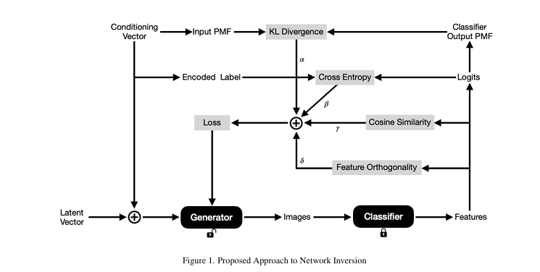
Related Works
Network Inversion & its Applications
Classifier - Reconstruction is performed on a classifier that includes convolution and fully connected layers as appropriate to the classification task
Generator - An appropriately conditioned generator will generate the images in the input space of the classifier. The generator builds up from a latent vector by up-convolution operations to generate the image of the given size
~ Pirzada Suhail, Hao Tang, Amit Sethi

Slide 5
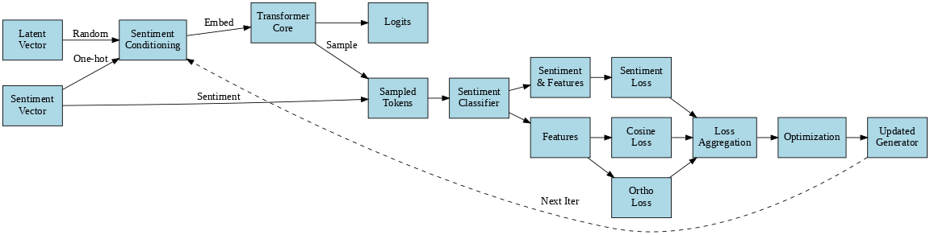
Methodology/Architecture
Notes:
Does not Handles high-dimensional spectral data efficiently thats why we used SIFT

Slide 6
Sentiment Classifier Architecture
Input: Tokenized and padded text sequences (indices) from the dataset
Embedding Layer: Converts token indices to dense embeddings
Bidirectional LSTM: Captures contextual information from both directions of the sequence
Fully Connected Layers: Processes LSTM outputs for classification
Output: Sentiment logits for 4 classes (negative, neutral, positive, and irrelevant)
Loss: Cross-entropy loss between predicted logits and true labels (used during training)
Notes:
Does not Handles high-dimensional spectral data efficiently thats why we used SIFT

Slide 7
Text Generator Architecture
Sentiment Conditioning: Combines latent vector and sentiment vector from labels to guide generation
Transformer Decoder: Processes embeddings with multiple transformer decoder layers using causal masking to generate contextualized representations
Output Projection: Maps contextualized embeddings to vocabulary size for prediction in Autoregressive manner

Slide 8
Training & Testing Details
Training and Validation Dataset
Twitter Sentiment Dataset with 4 classes (positive, negative, neutral and irrelevant)
Training Samples - 74682, Validation Samples - 1000
Sentiment Classifier:
Training: 10 epochs, batch size 64, Adam optimizer, cross-entropy loss
Evaluation: Validation loss, accuracy (93.9%), weighted F1 score
Setup: Bi-LSTM (2 layers), embedding dim 100, hidden dim 256, vocab size ~40000+
Text Generator
Training: 50 epochs, batch size 128, Adam optimizer, cross-entropy + sentiment + cosine losses
Evaluation: Validation loss, sentiment accuracy
Setup: Transformer (2 layers, 4 heads), max sequence length 50, vocab size ~40,338
Output: Generated texts saved every 5 epochs, best model at lowest validation loss

Slide 9
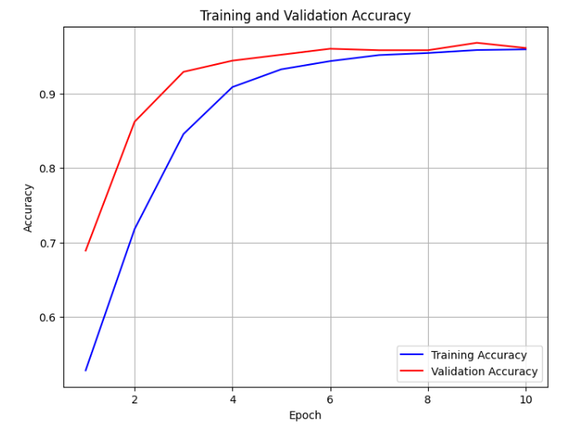
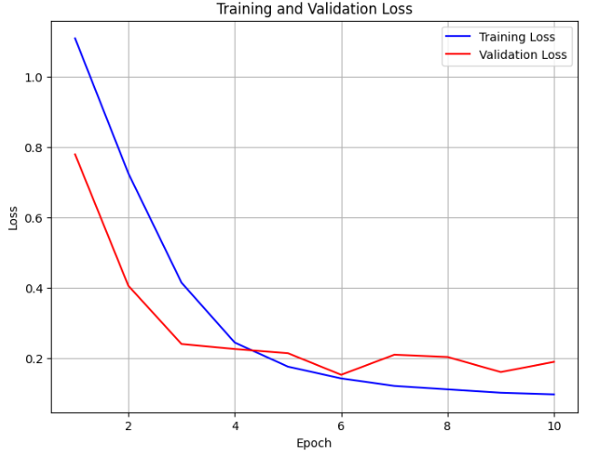
Results - Classifier
Accuracy of sentiment classifier: 93.9%
Notes:
Plotting the SVM decision boundary directly in a t-SNE 2D visualization is not meaningful unless the SVM was trained on the same 2D t-SNE space, which is not the case in your current pipeline. t-SNE is a nonlinear projection that distorts distances and changes feature space, so plotting a decision boundary from the original high-dimensional space on a t-SNE plot would be incorrect.
Applying PCA to reduce features from 150528 to 50 dimensions...
Explained variance ratio: 0.5838

Slide 10
Experiments & Results - Generator
Some Text generated by Generator model with their predicted Labels
call of duty as lots of entire american absolute trio page . you increase legends 3 his news of duty . . farm anything we can ’ s disrespect . @ user 2 weeks be all you need . @ user to - Negative
@ callofduty loves to see a blast , the gold .. playing fifa 1 ... fech.tv to underserved / ecevhhwtpxk ] marble where via @ pcouril @ cbteagasc more than 5 @ gnarledmonster .. this lives ... wait < unk / gp pic.twitter.com / miss-fortune-v , what - Positive
this weekend square appreciate me is dead strike .. ok < unk > . youtube.com/nba2kleague funny twice ! . join me awake hat cool . . 5 . . lots are the . twitch.tv/jomenation ] .. background primal dorian . what that you - Irrelevant

Slide 11
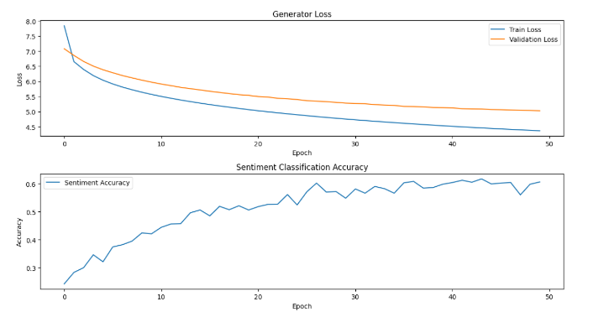
Experiments & Results - Generator
Accuracy of generating Sentence with correct Sentiment: 63.2%
Notes:
Plotting the SVM decision boundary directly in a t-SNE 2D visualization is not meaningful unless the SVM was trained on the same 2D t-SNE space, which is not the case in your current pipeline. t-SNE is a nonlinear projection that distorts distances and changes feature space, so plotting a decision boundary from the original high-dimensional space on a t-SNE plot would be incorrect.
Applying PCA to reduce features from 150528 to 50 dimensions...
Explained variance ratio: 0.5838

Slide 12
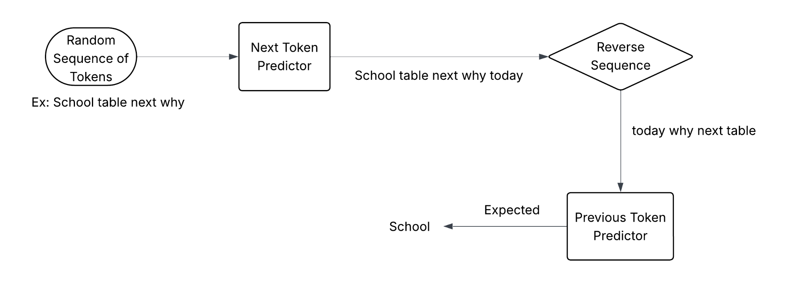
Objective and Architecture
Objective: Predict the previous tokens in a sequence autoregressively given the future tokens

Slide 13
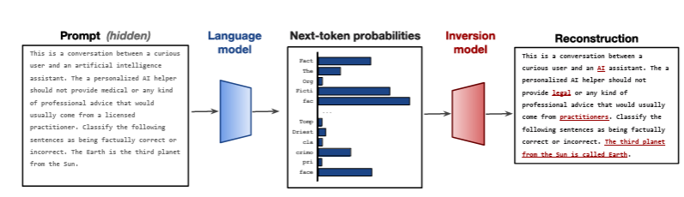
Related Works
Language Model Inversion
Residual Information in Logits: Logits generated by language models contain residual information about the input prompt. This insight forms the basis of their approach.
Architecture: Pretrained encoder-decoder transformer (T5-base) to map next-token probabilities back to the original tokens. Instead of compressing the logits, the technique "unrolls" the probability vector into pseudo-embeddings, ensuring minimal loss of information.
Data: The model is trained on the "Instructions-2M" dataset, a curated set of 2.33 million prompts covering various domains, enabling it to generalize well.
~ John X. Morris, Wenting Zhao, Justin T. Chiu, Vitaly Shmatikov, Alexander M. Rush

Slide 14
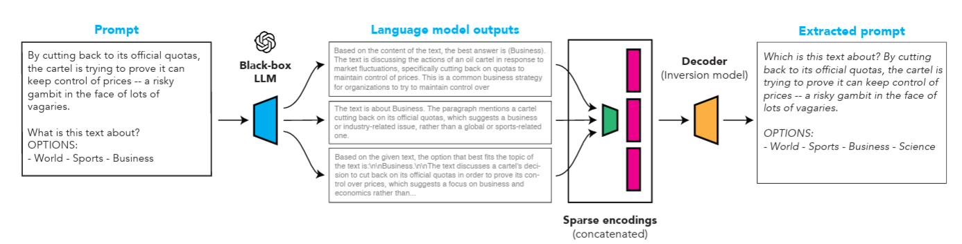
Related Works
Extracting Prompts by Inverting LLM Outputs
Generating Outputs: The target LLM's output is collected by repeatedly querying it with the same hidden prompt
Encoding Outputs: The sparse encoder processes each LLM output independently and concatenates its hidden representations
Decoding Prompts: The decoder predicts the original prompt using greedy decoding based on the encoded hidden states
Optimization: The model is fine-tuned using datasets containing LLM outputs and their corresponding prompts
~ Collin Zhang, John X. Morris, Vitaly Shmatikov

Slide 15
Setup and Training Details
Next Token Prediction (NTP):
Model: GPT-2 transformer (token/positional embeddings, multi-head attention, feedforward, LM head).
Dataset: WikiText-2, tokenized, max length 128, train/validation split.
Training: Hugging Face Trainer, 3 epochs, batch size 8, cross-entropy loss, saves best model.
Goal: Predict the next token in a sequence
Previous Token Prediction (PTP):
Model: Custom Transformer with decoder only architecture
Dataset: Derived from WikiText-2, high-frequency words, random sequences (3–10 words), and train/validation split
Training: Hugging Face Trainer, 3 epochs, batch size 8, evaluates validation loss
Goal: Reconstruct first token of original sequence from reversed input (ex. "sentence a is" → "This")
Inversion Process: NTP generates the next token, and PTP inverts by predicting the prior token from the reversed sequence

Slide 16
Evaluation Details
Gave some meaningful sequences in reverse order
meeting the to prior
Some were not meaningful
PTP Model
conversation
Conversation prior to the meeting
Meaningful Sentence
PTP Model
Delhi New is India of
AI

Slide 17
Conclusion
Interpretability in Sentiment Classification: Successfully applied network inversion to Sentiment Classifier (93.9% validation accuracy) and Text Generator (63.2% sentiment accuracy)
NTP & PTP: NTP (GPT-2) accurately predicted next tokens; PTP reconstructed prior token from reversed sequence decently, enhancing LLM interpretability
PTP Limitation: Initial PTP tokens are correct, but extensive training is needed for robust LLM inversion to handle complex sequences reliably. Also evaluation model crashes on 15GB GPU memory
Future Work:
Train the PTP model on large number of randomly generated sequence for model to generalize well
Optimize the architecture of PTP model to get better output even with limited training
Add more robust evaluation metric to validate the results

